Slide 1

Big Data
REDIS
Luc De Cleene

Slide 2
Agenda
Key-Value DB
Redis introduction
Demo

Slide 3
Key-Value DB > Concept
Key
String
Indexed
Sorted
Value
Random data, Blob
Not Indexed

Slide 4
Key-Value DB > More
Schema: None
Transactions: applicable to a single key
Basic operations:
PUT(key, value)
GET(key)
REMOVE(key)
Queries: Only on the keys !!
Notes:
Schema is just key-value, you can structure your data however it suits you best.

Slide 5
Key-Value DB > Key index
user1_age ----- 18
user2_age ----- 48
user3_age ----- 26
user4_age ----- 18
Get all users of age 18?
age18 ----- [ user1, user4 ]
age26 ----- [ user3 ]
age48 ----- [ user2 ]
Notes:
Change the direction of the data

Slide 6
Key-Value DB > Databases
Membase
LevelDB
Aerospike
Tokyo Cabinet
Project Voldemort
Hyperdex
Redis
Notes:
Why did I choose to for Redis?
All of these databases probably have some advantage.
Not all are as mature as Redis.
Redis is widely used!

Slide 7
Key-Value DB > Why Redis?
Rank | Last Month |  | DBMS | Database Model | Score | Changes
1. |  | 1. | Oracle | Relational DBMS | 1439.72 | +0.56
2. |  | 2. | MySQL | Relational DBMS | 1272.45 | -5.06
3. |  | 3. | Microsoft SQL Server | Relational DBMS | 1177.48 | -21.13
4. |  | 5. | MongoDB | Document store | 267.24 | +16.35
5. |  | 4. | PostgreSQL | Relational DBMS | 262.34 | +7.85
6. |  | 6. | DB2 | Relational DBMS | 202.42 | +2.29
7. |  | 7. | Microsoft Access | Relational DBMS | 140.54 | +1.41
8. |  | 8. | Cassandra | Wide column store | 107.08 | +8.34
9. |  | 9. | SQLite | Relational DBMS | 99.56 | +3.37
10. |  | 10. | Redis | Key-value store | 99.21 | +4.97
Source: http://db-engines.com/en/ranking
Source
Notes:
I looked it up and here are the results.

Slide 8
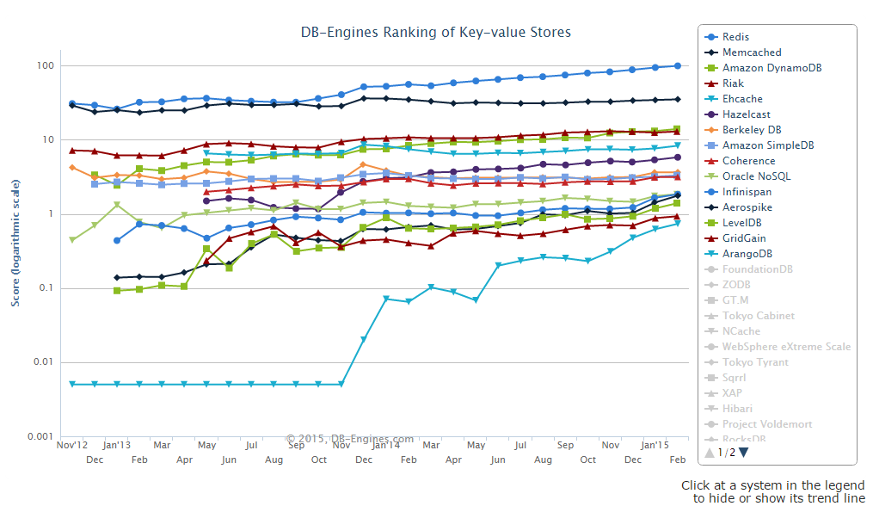
Key-Value DB > Why Redis?
Source: http://db-engines.com/en/ranking_trend/key-value+store
Source
Notes:
Compared to the other Key-Value datastores, there is a huge gap.

Slide 9

Redis

Slide 10
Redis > Details
Redis is an in-memory but persistent on disk database
Very high write and read speed
Data sets can’t be larger than memory
Various data-types are supported
Strings, Lists, Sets, Sorted Sets, Hashes
Execute atomic operations at DB level, not client level
Append to string
Left/right push to a list
Compute set intersection/union/difference
Get highest ranked members in sorted set
,,,
Notes:
It runs completely from memory.
There are backup-systems for not loosing data on shutdown/restart/etc
Snapshotting: writes the data to an RDB file
- Your last written data is lost when your server unexpectedly stops
Append-only file: fully-durable strategy, every set is appended to an AOF file
Very fast atomic operations on supported data types.

Slide 11
Redis > Details
Master-slave asynchronous replication
Read-only slaves (by default)
Slave configuration in 1 line/command
Set up a slave
1) New slave will send SYNC command
2) Master will persist it’s data to disk and send this file to slave
3) Master will open a stream with buffered commands
Redis 2.8 onwards, partial resync possible
consistency is not ensured
Automatic failover to promote a slave to master
Publish/Subscribe system
Notes:
SLAVEOF 192.168.1.1 6379

Slide 12
Redis > Details
Transactions
MULTI starts a transaction, EXEC starts the execution
Executed sequentially (single isolated operation)
Single write to append-only file
Possibility to expire keys
LRU cache
Automatically evict old data when max memory reached
LRU: less recently used
Random
Notes:
It can never happen that a request issued by another client is served in the middle of the execution of a Redis transaction.

Slide 13
Redis > use-cases
In-memory cache
Leaderboard
Pinterest
http://blog.pivotal.io/pivotal/case-studies-2/using-redis-at-pinterest-for-billions-of-relationships
Twitter
http://blog.pivotal.io/pivotal/case-studies-2/case-study-staple-yourself-to-a-tweet-to-understand-30-billion-redis-updates-per-day
Viacom
http://blog.pivotal.io/pivotal/case-studies-2/8-ways-media-giant-viacom-uses-redis-to-serve-dynamic-video-at-scale
Superfeedr
http://blog.pivotal.io/pivotal/case-studies-2/22-billion-served-julien-genestoux-of-superfeedr
Notes:
MORE:
http://blog.pivotal.io/pivotal/case-studies-2/case-study-how-hulu-scaled-serving-4-billion-videos-using-redis

Slide 14
Demo

